Slide 1


Al-Karkh University for Science
Collage of Science
Medical Physics Department
General Biology II
" Practical"
Prepared by
Dr. Hiba Shakir Ahmed Dr. Rawa Abdul Redha Aziz
Ph.D Microbiology/Immunity Ph.D Antibiotic Molecular Biology
Gada Readh Hassan
MS.c of Biotechnology

Slide 2
Protozoa
Lab ((6))

Slide 3
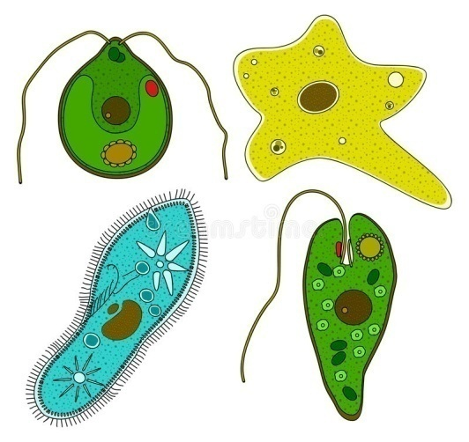
Protozoa
They are a large group of single-celled, usually microscopic, eukaryotic organisms, such as amoebas, ciliates, flagellates, and sporozoans.

Slide 4
The characteristics of these microorganisms are:
Microscopic organisms
Eukaryotic unicellular
Small size: 10 to 52 µm
No cell wall
Mostly heterotrophic
Very dependent on moisture
Mostly motile with flagella, cilia or amoeboid
Similar to animal (mobility and heterotroph), only unicellular
Protozoa depends on: pH, temperature, nutrition and some depends on sunlight

Slide 5
Habitat: they can grow in marine habitat, fresh water, soil, mosses or symbiotic, or parasites in other organisms (most protozoa are parasites)
Feed by:
Osmotrophy
Phagocytosis
Cytostome
Reproduction in these organisms varies, but most genera reproduce either asexually or sexually.

Slide 6
The importance of protozoa are:
Some protozoa are an important food source for microinvertebrates
They control bacteria populations and biomass to some extent
They can stimulate decomposition of organic matter
They can play a role in nutrient mobilization

Slide 7
The protozoa are classified into four classes on the basis of the structures they possess for locomotion:
Class | Locomotion structure | Example
Mastigophora | Flagella whip-like structures | Euglena
Ciliate | Cilia hair-like structures | Paramecium
Sarcodina | Pseudopodia foot-like structures | Amoeba
Sporozoa | Non-motile without locomotion structure but move by gliding | Plasmodium

Slide 8
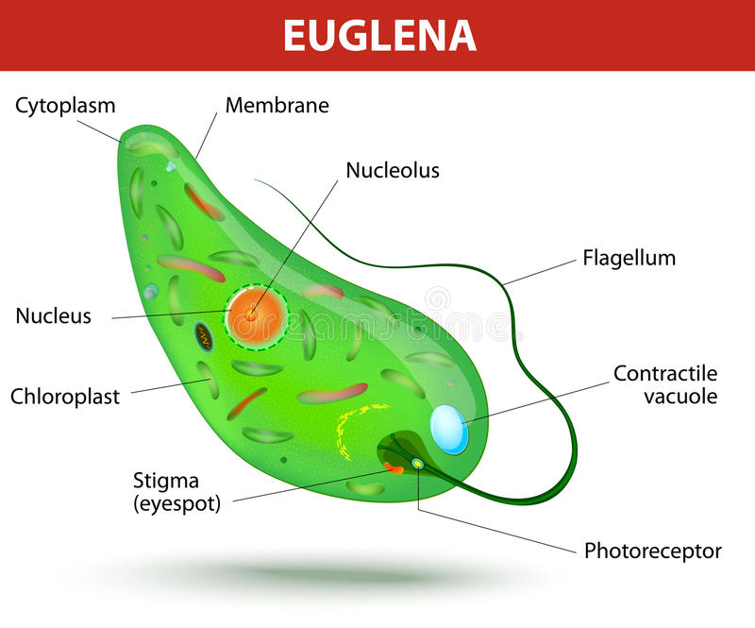
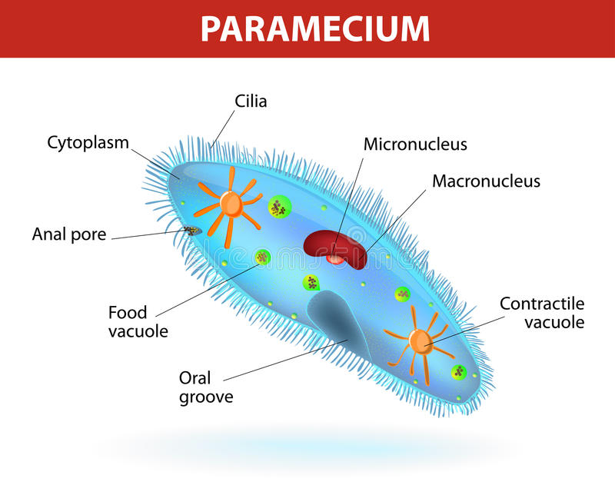
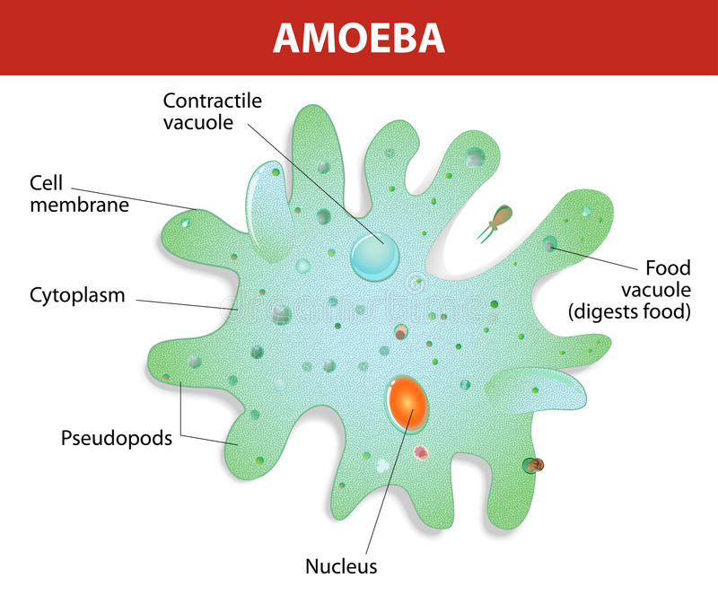
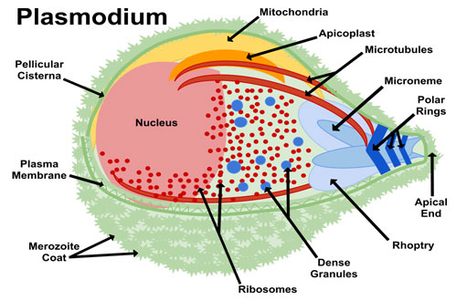

Slide 9
Examples of major pathogenic protozoa
Source | Diseases | Protozoan
 |  | Amoeboid protozoa
Humans, water and food | Amoebiasis (intestinal and other symptoms) | Entamoeba histolytica
 |  | Ciliated protozoa
Pigs, cattle | Balantidiosis (intestinal and other symptoms) | Balantidium coli
 |  | Flagellated protozoa
Animals, water and food | Giardiasis (intestinal distress) | Giardia lamblia
 |  | Nonmotile protozoa
Human, vector-borne | Malaria (cardiovascular and other symptoms) | Plasmodium vivax

Slide 10
